Slide 1

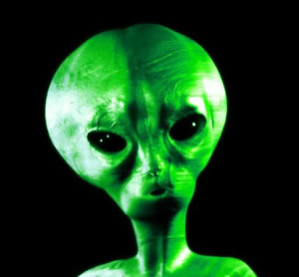
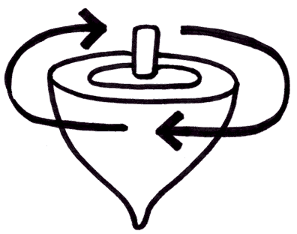
event
“Finding the
TRUTH”
flow-chart
study of facts = evidence
1) what HAPPENED
evaluation of evidential reliability
2) what was SAID
evaluation of souce credibility
analysis of above
logic & reason - avoiding: - prejudice
- preconceived ideas
- received wisdom
- Political Correctness
summary of facts
& evidence
interpretation thereof
conclusions
1 – 2 – 3 – 4
beware of ‘spin’

Slide 2
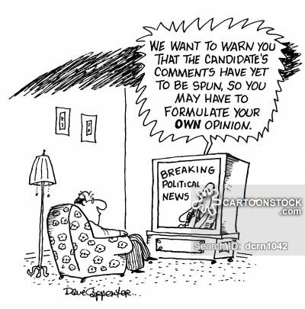
“SPIN”

Slide 3
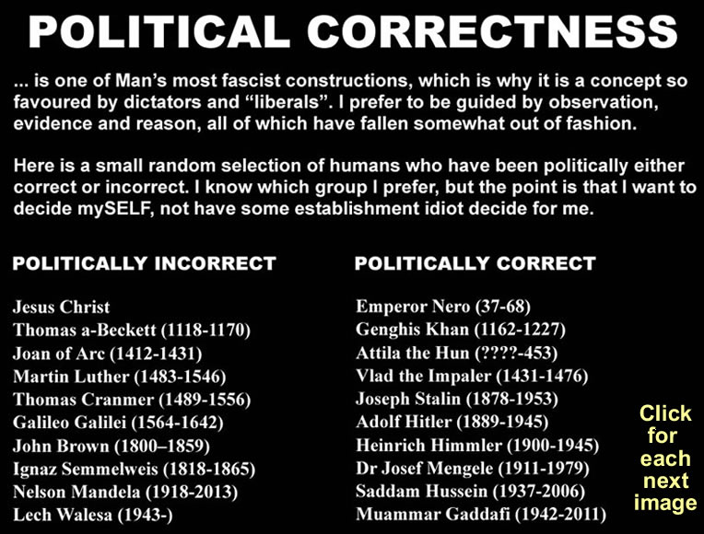

Slide 4
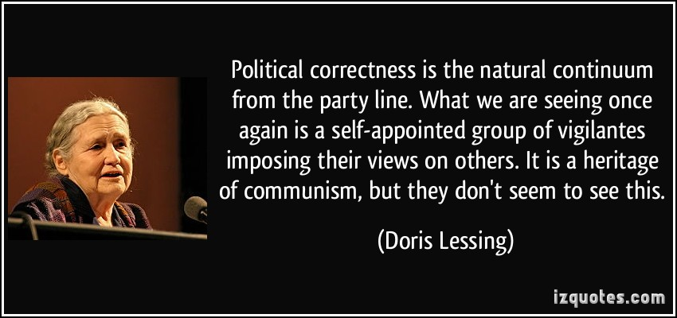
“Political Correctness”

Slide 5
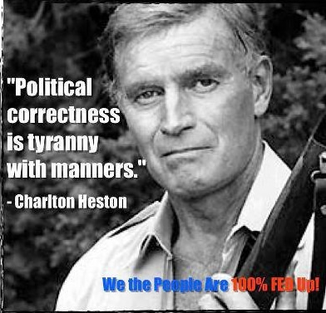
“Political Correctness”

Slide 6

“Political Correctness”

Slide 7
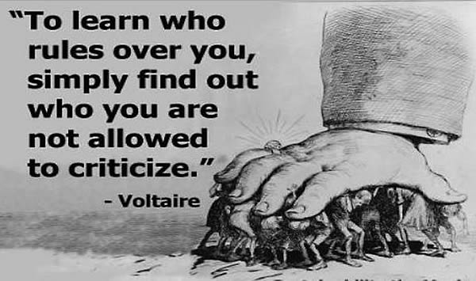
“Political Correctness”

Slide 8
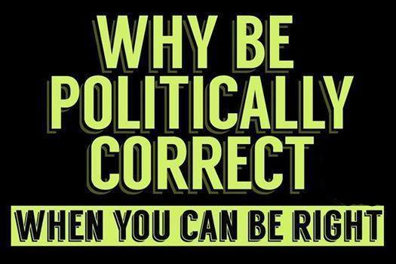
“Political Correctness”

Slide 9
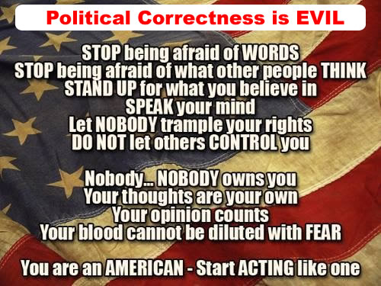
“Political Correctness”

Slide 10
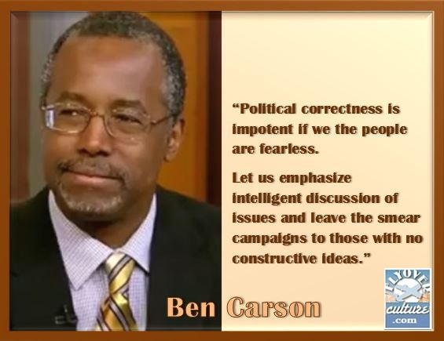
“Political Correctness”

Slide 11
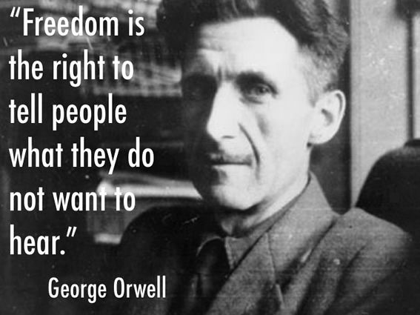
“Freedom”

Slide 12
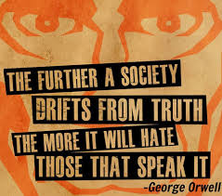
“Political Correctness”

Slide 13
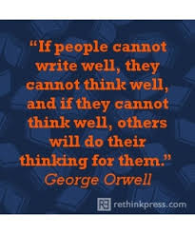
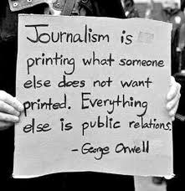
“The Written Word”

Slide 14
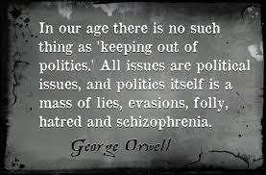
Politics

Slide 15
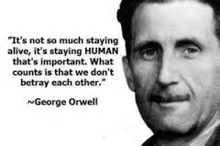
“What Is Important”

Slide 16
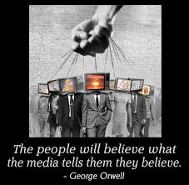
“Who Controls
The Truth?”

Slide 17
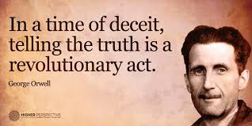
“Times of Deceit”

Slide 18
“Political Correctness”

